Slide 1
Solving CTF with Python
Name :穆里婭
Teacher :林建良

Slide 2
Agenda

Slide 3
Google Colab
Colaboratory, or "Colab" for short, allows you to write and execute Python in your browser, with
Zero configuration required
Free access to GPUs
Easy sharing

Slide 4
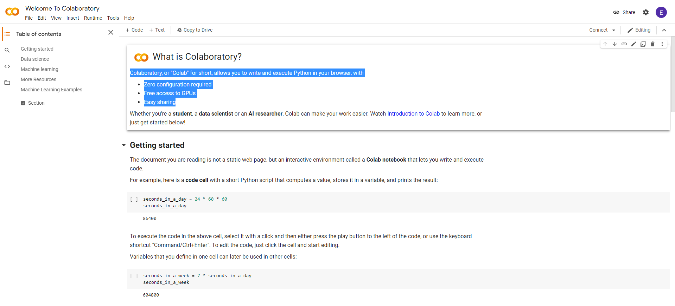

Slide 5
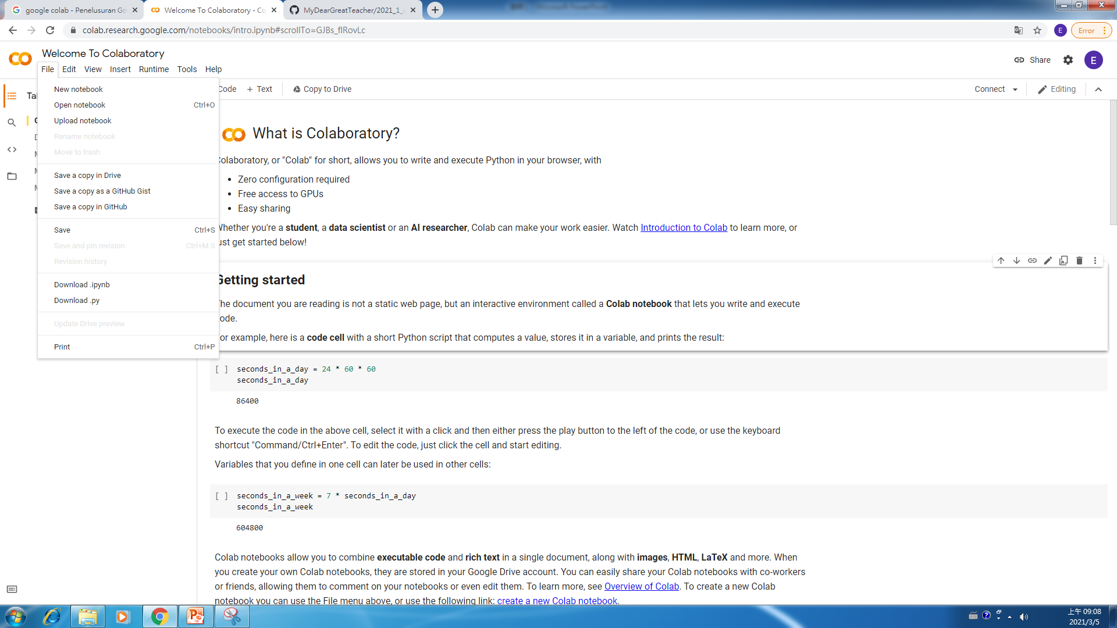

Slide 6
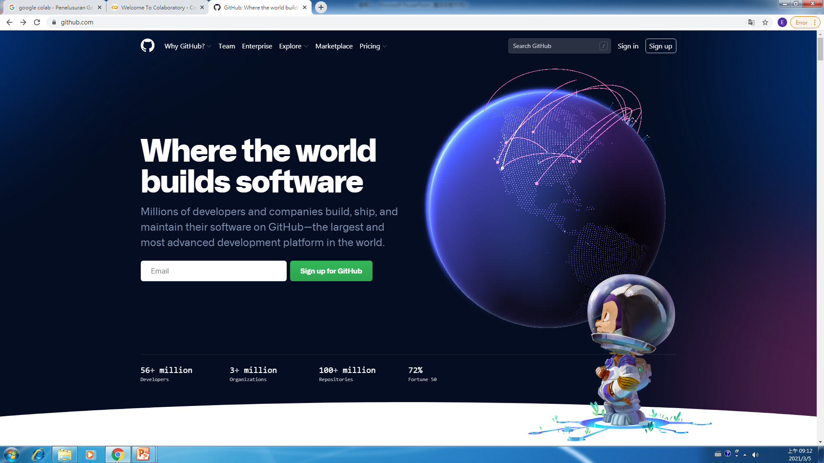

Slide 7
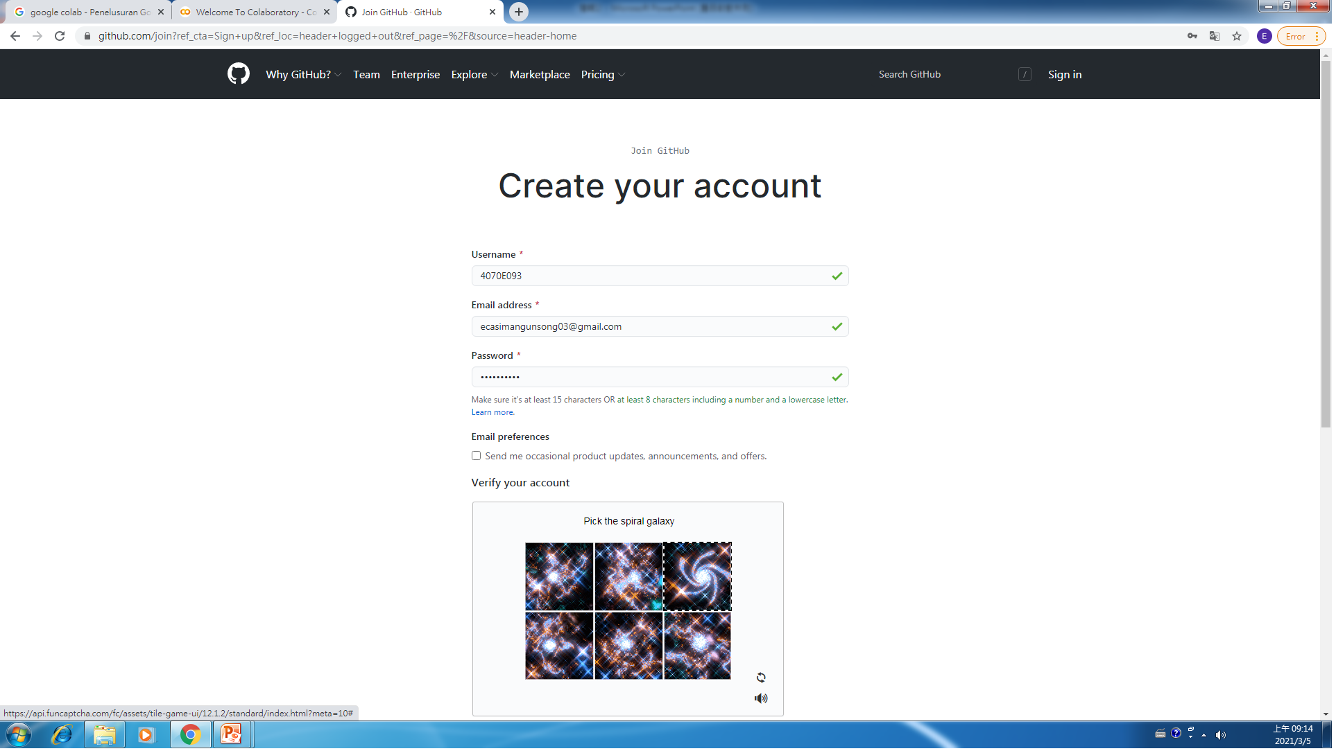
https://github.com/mydeargreatteacher

Slide 8
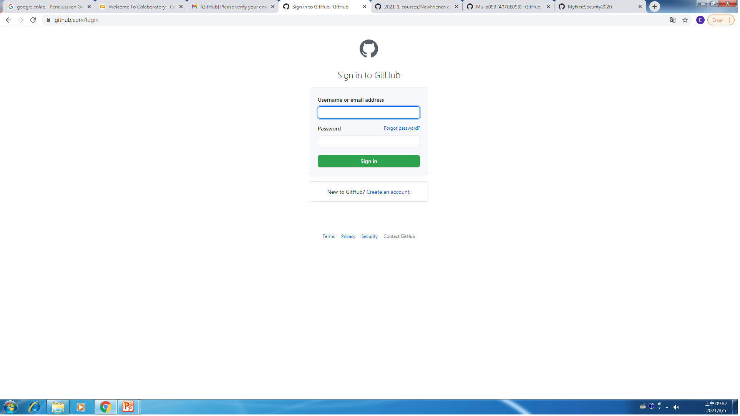

Slide 9
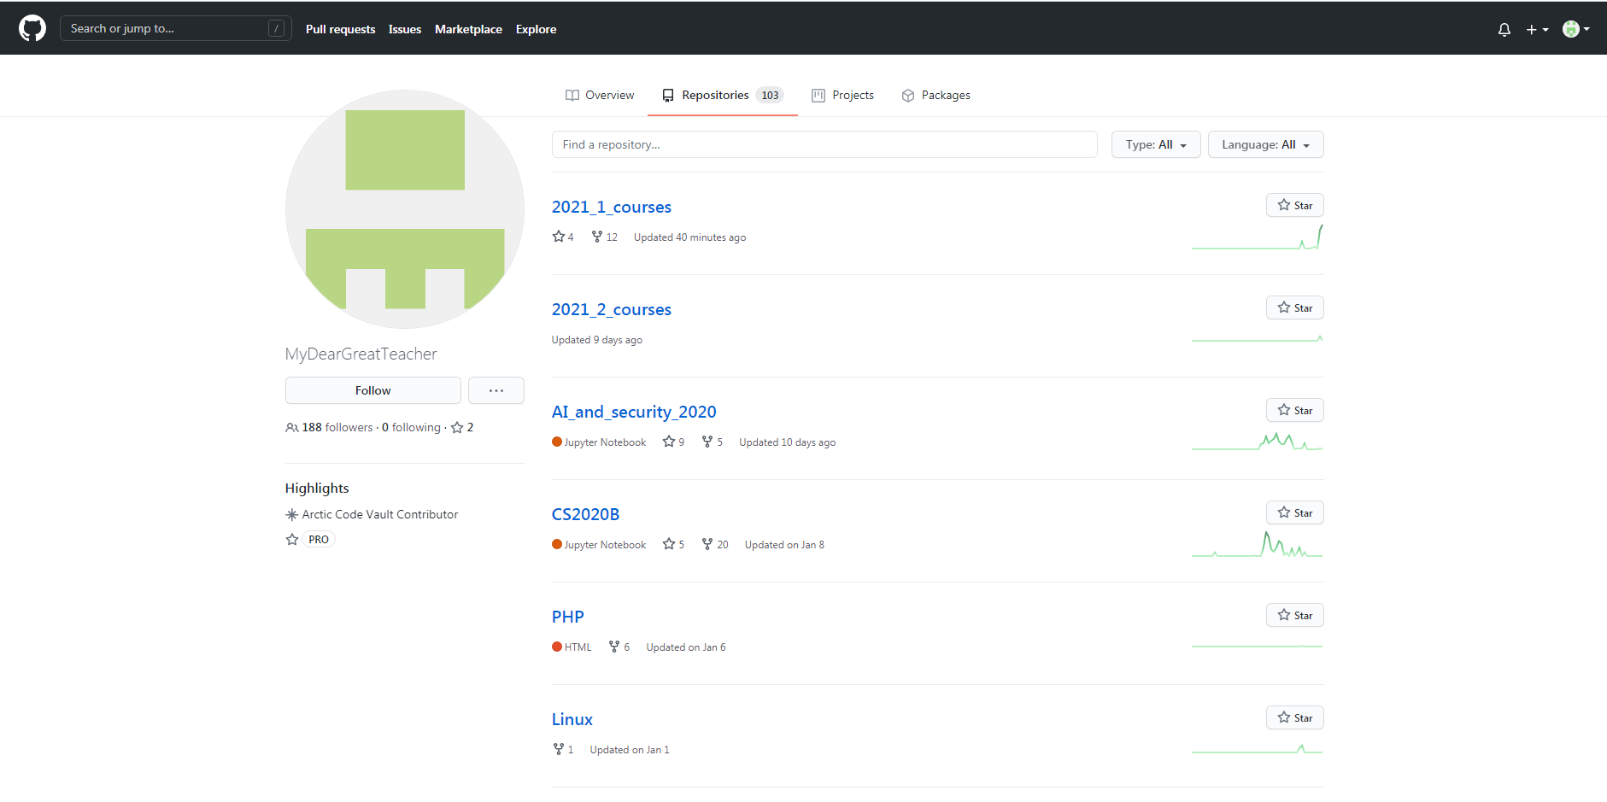

Slide 10
